Slide 1
Sciencebois
Avery Pawelek
Negin Rahbar
Russel Gates
Tomi Ulobeko
Dylan Cooledge

Slide 2
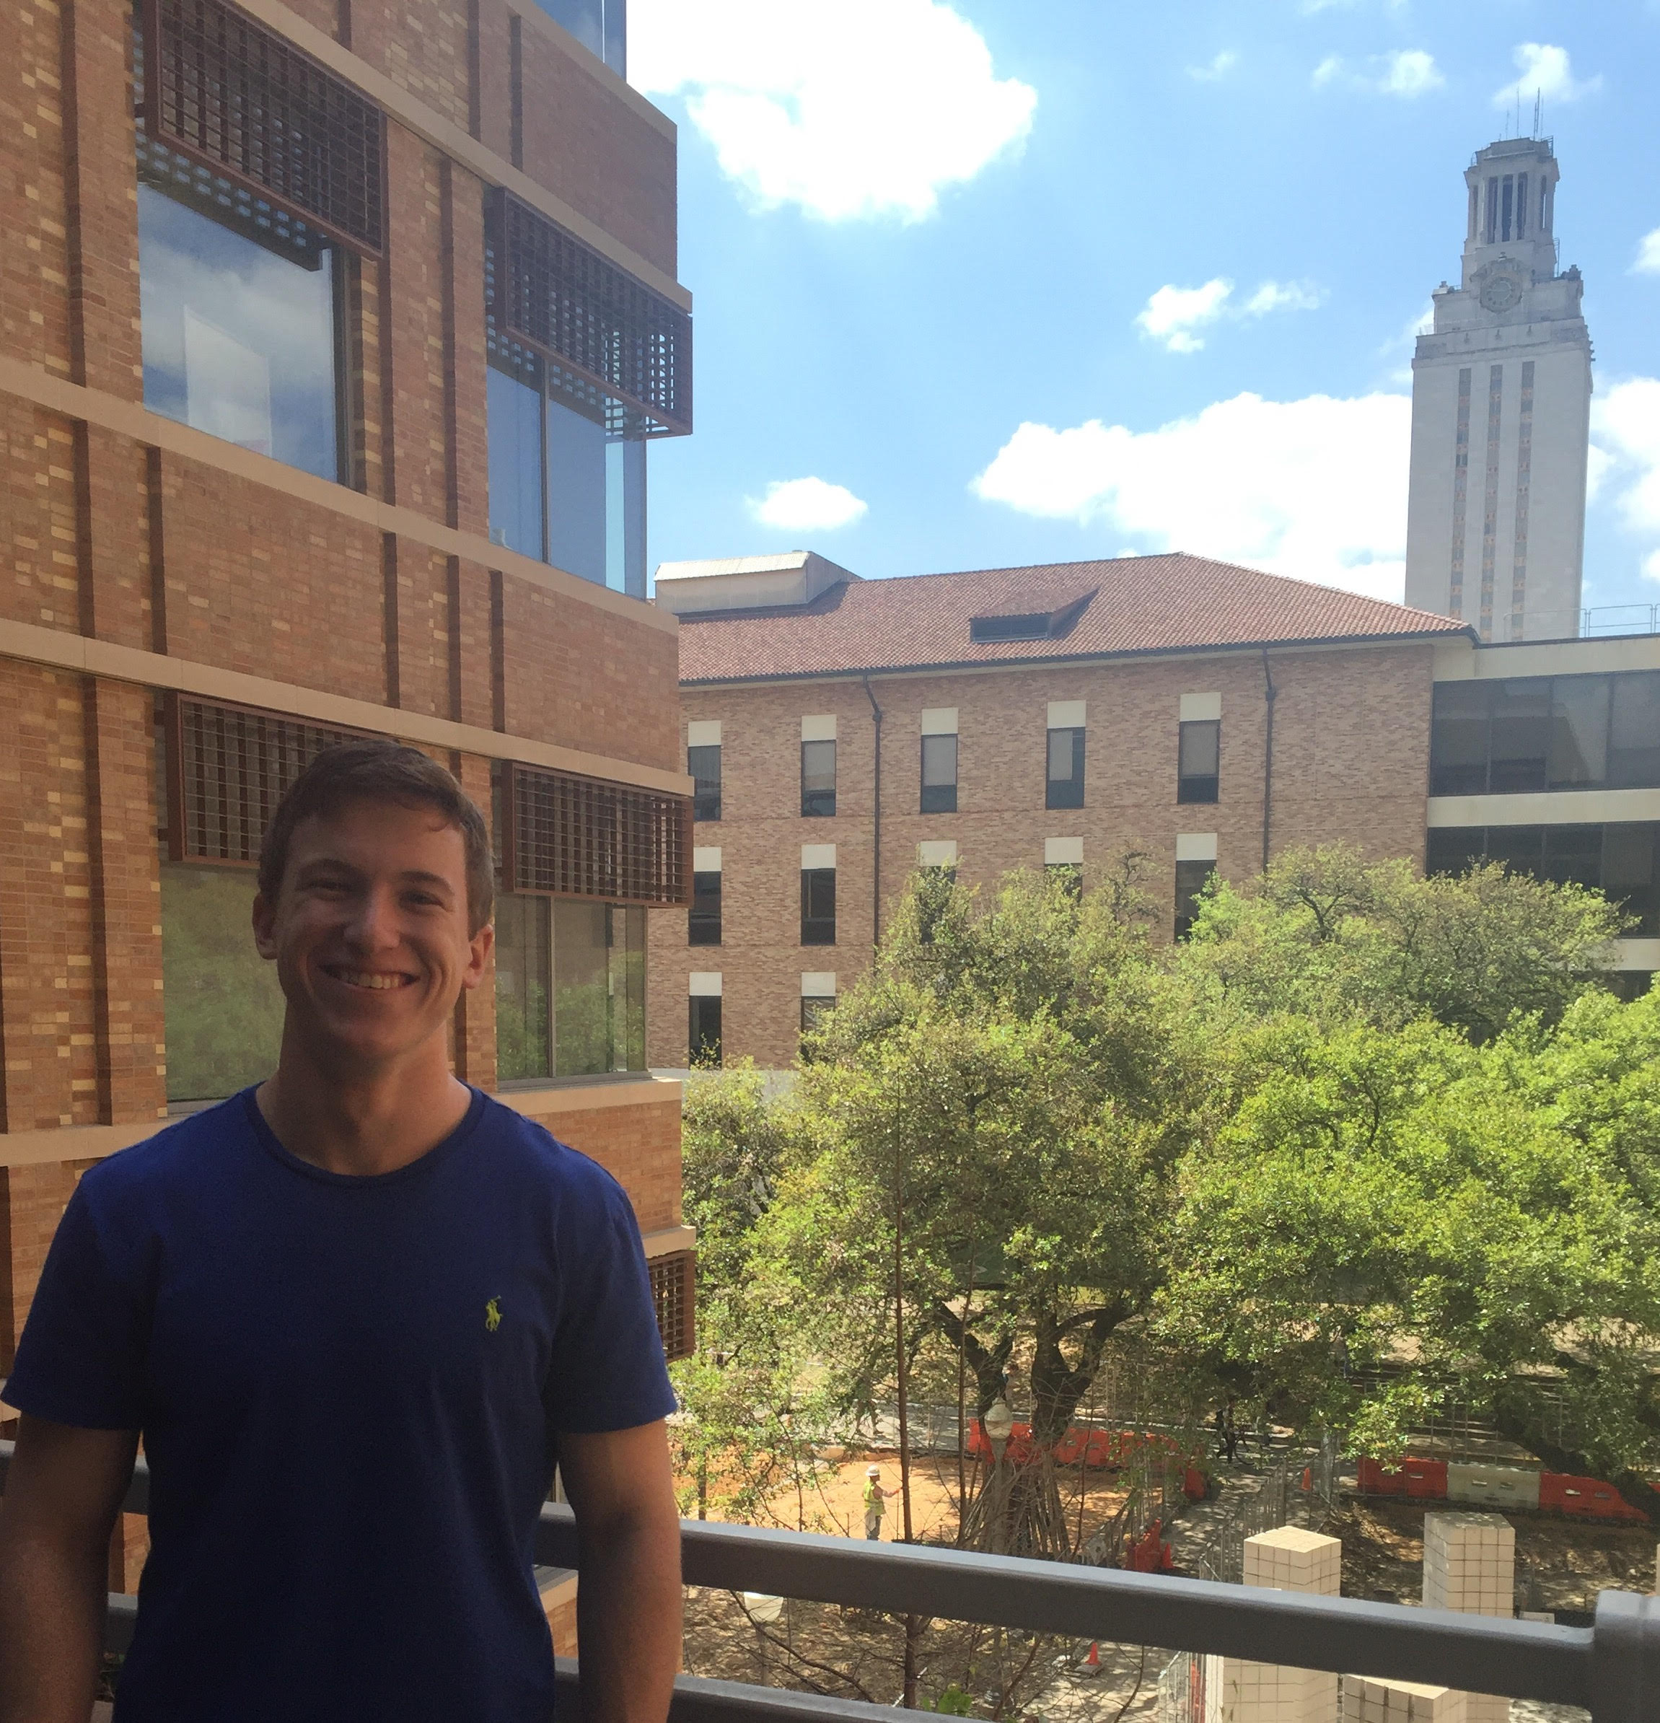
Avery Pawelek
I am a physics and mathematics student from a tiny town.
Responsibilities:
Scientific Fields model
Scientific Fields pages
Linking of pages
Meeting organizer
13 commits

Slide 3
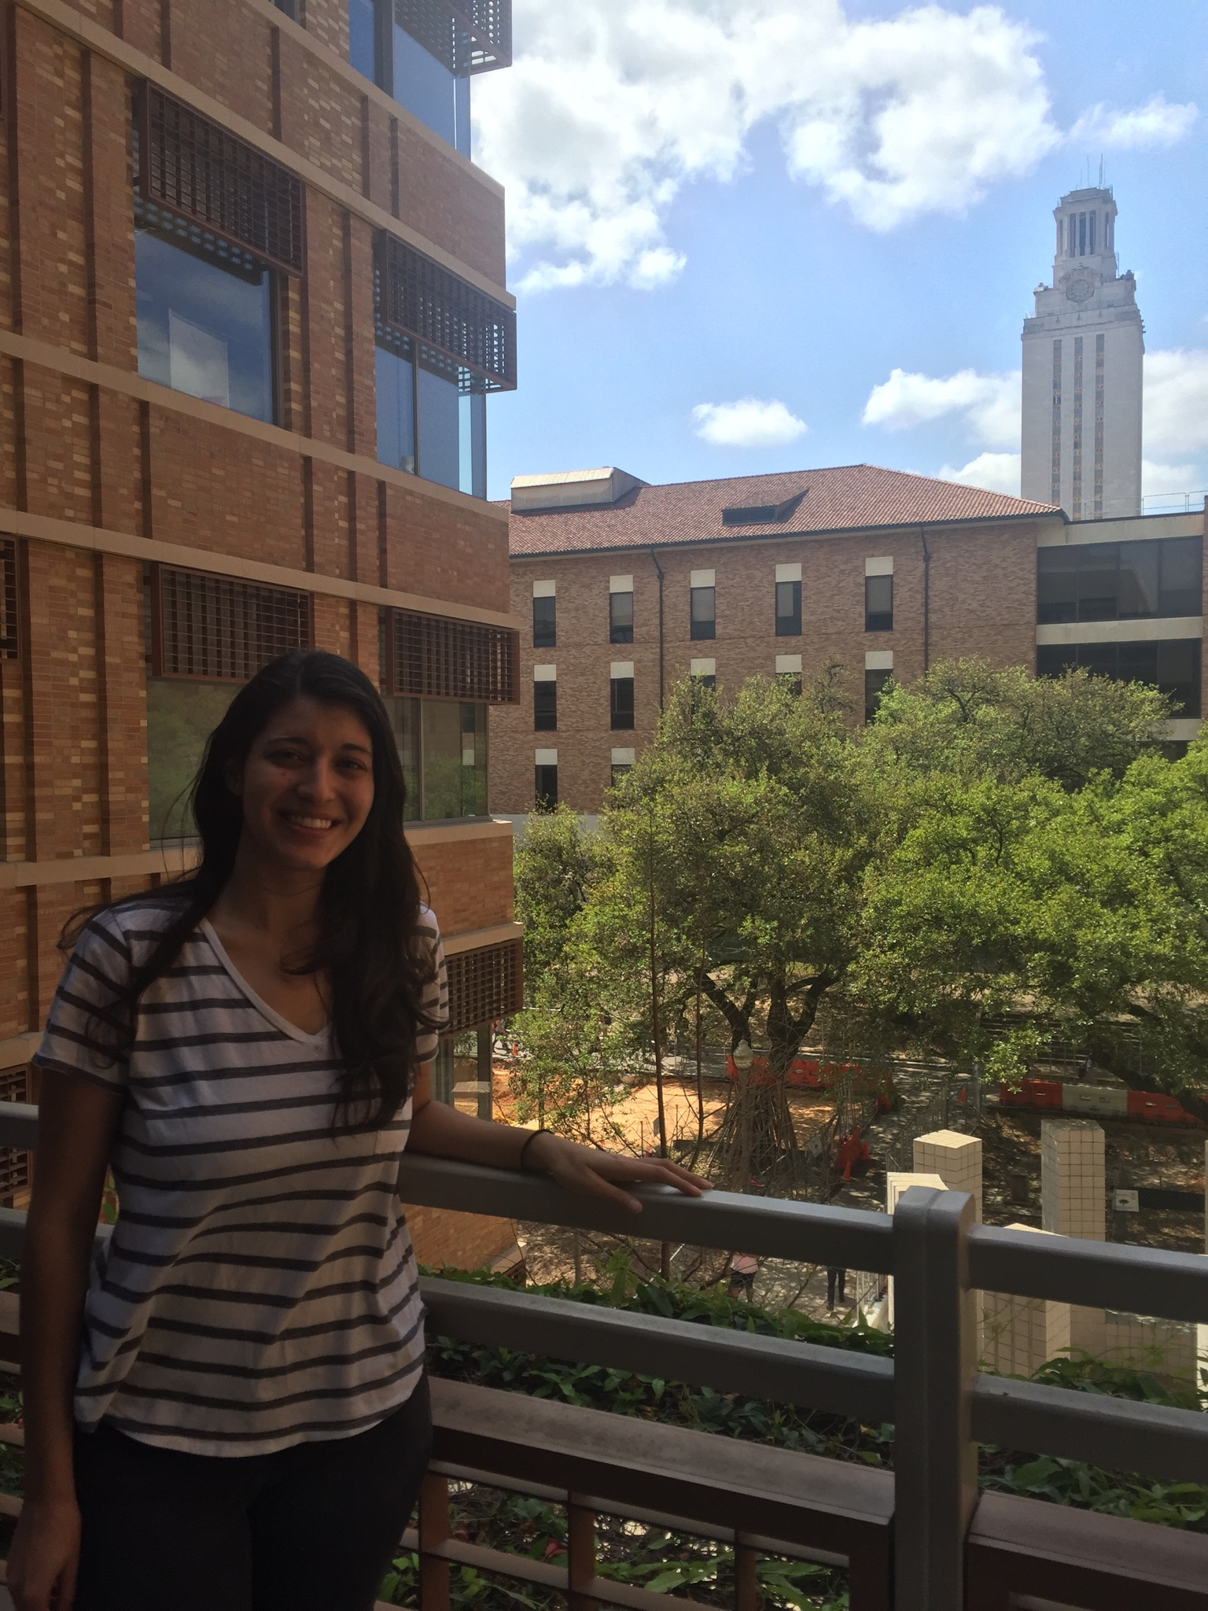
Negin Rahbar
I am not afraid to commit.
Responsibilities:
CSS
Technical Report
Splash page
6 issues
39 commits

Slide 4
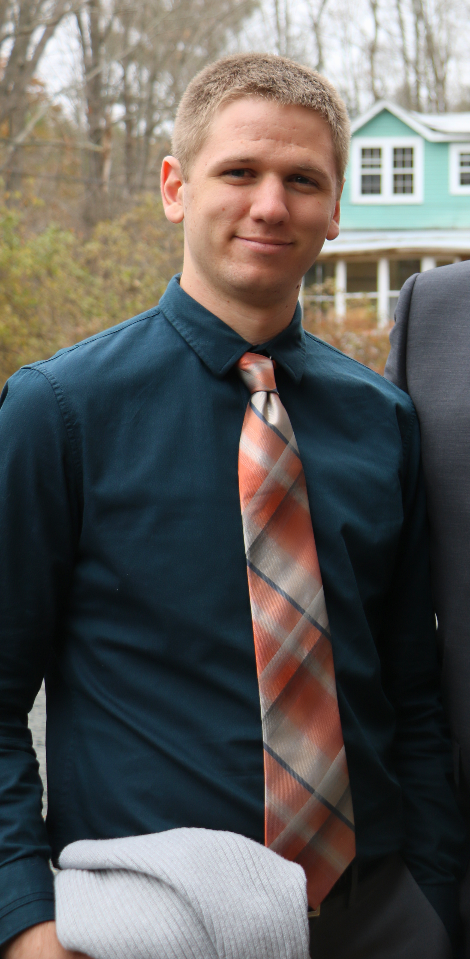
Russell Gates
Mathematics major at The University of Texas at Austin by day, Sm4sh noob by night.
Responsibilities
Hosting
Page Navigation
Documentation
17 commits
10 issues

Slide 5
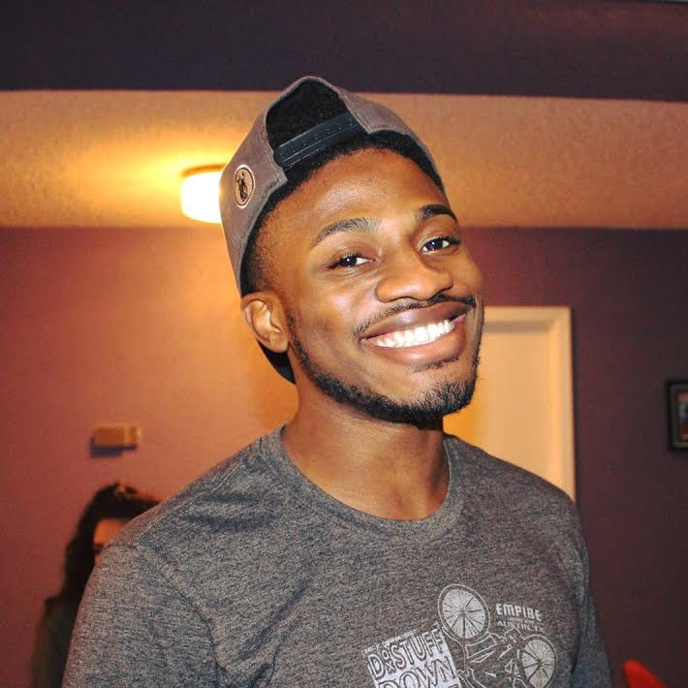
Tomi Olubeko
Mathematics Major at UT. I enjoy playing soccer and pwning Rusty at Smash.
Responsibilities:
Made the table for the theories
Made the theory html pages
5 commits
Added pagination to theorymodel.html
Added pagination to scientistmodel.html
Added pagination to fields.html

Slide 6
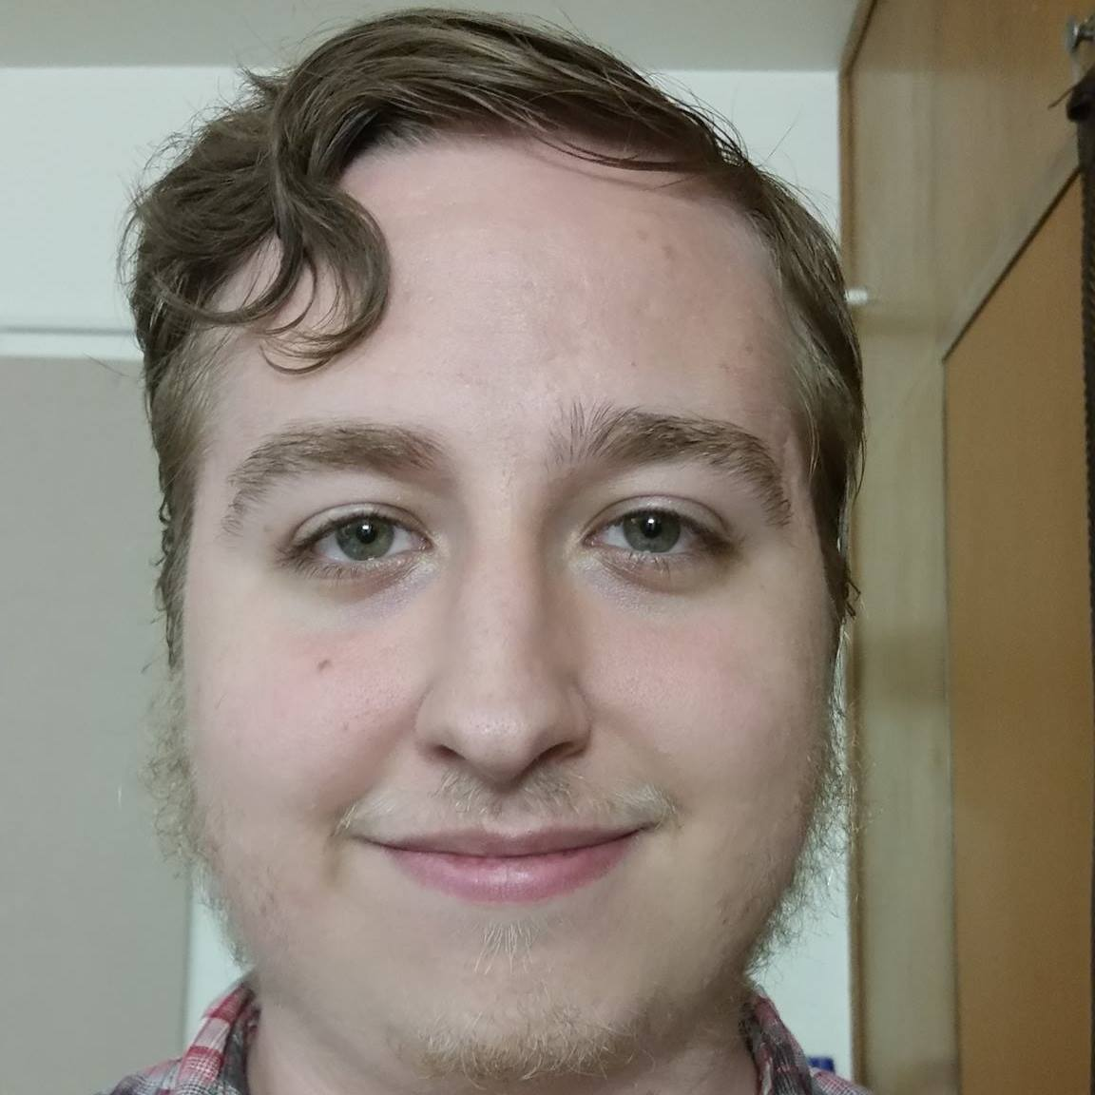
Dylan Cooledge
I like computer science and robots.
Responsibilities:
Scientists model
Scientists' pages
28 commits
6 issues

